Slide 1

How to Train Your Dragon and Its Friends: AI on the Edge with Eclipse Kura
Pierantonio Merlino
Mattia Dal Ben
Eurotech

Slide 2




Outline
Who are we?
Why AI on the Edge?
Know your dragon: Eclipse Kura AI APIs
What problem are we going to solve today?
Introduction to Anomaly Detection
Tutorial
Upcoming features
Notes:
In this presentation we’ll describe the concept on EDGE AI and how Eclipse Kura can be used for implemention ML algorithm on the field.
We’ll go in to the details of this topic with a tutorial about anomaly detection.

Slide 3


Who are we?
Pierantonio Merlino was born in Udine, Italy, in 1980. He graduated in Electronic Engineering (summa cum laude) from the University of Udine, Italy, in 2005 and he received a Ph.D. degree at the same University in 2009. After several years in hardware research, he switched to software development. He joined Eurotech in 2014 and started working on ESF. He is Eclipse Kura committer since 2015.
Mattia Dal Ben graduated in Electronic Engineering at the University of Udine, Italy. He is currently working as Software Engineer at Eurotech in the ESF team. He worked on multiple deep learning projects concerning image processing and anomaly detection.
Notes:
But, first of all, let’s introduce ourself. The presentation we’ll be hold by me and Mattia. We currently work at Eurotech and I’m a committer of Kura since 2015.

Slide 4
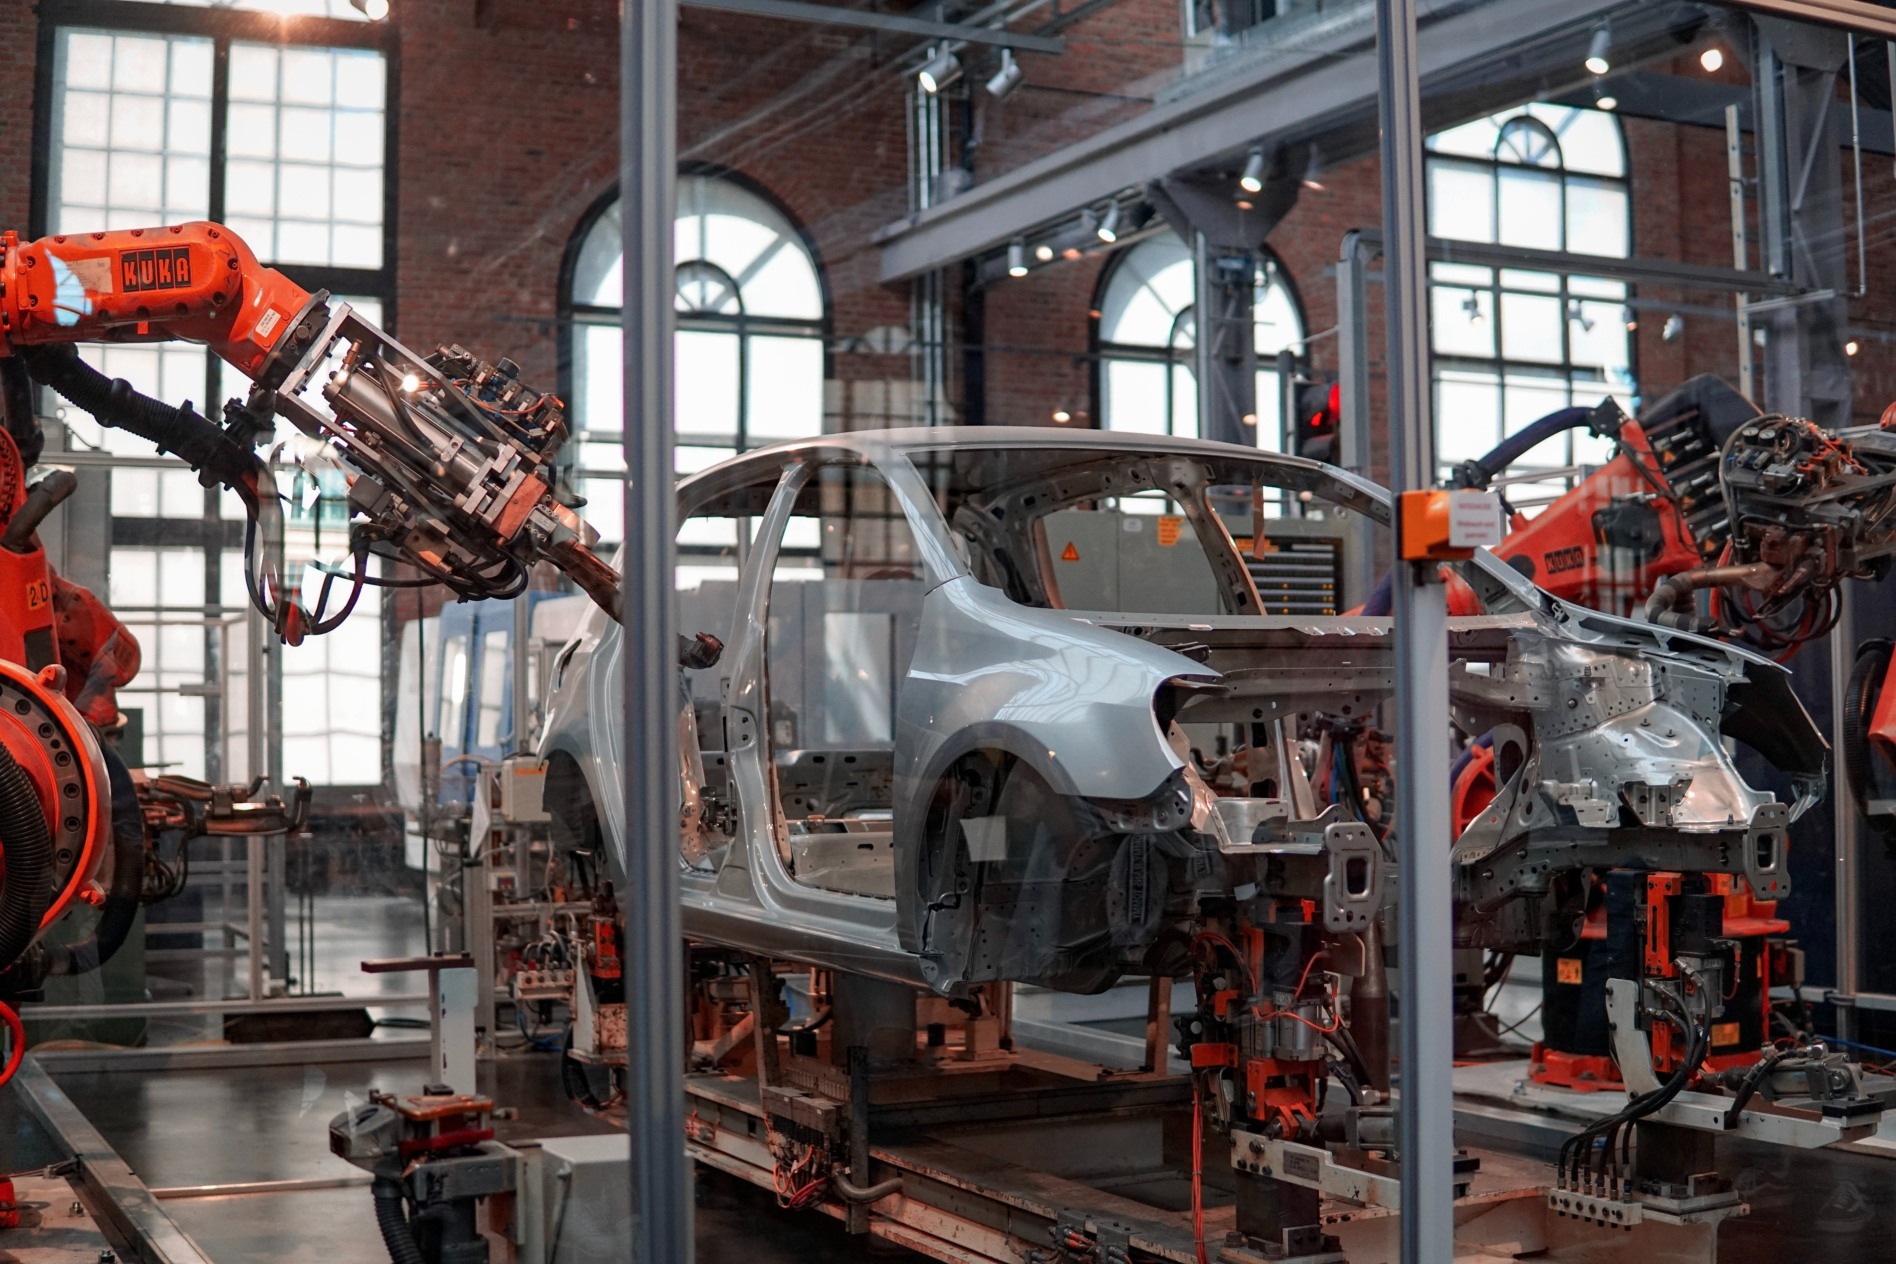



Why AI on the Edge?
Edge AI is the deployment of AI applications in devices close to where the data are located and collected.
It puts together the best of two worlds:
Lower latency, lower network requirements, increased efficiency, data privacy and security, reliability and resilience, …
Increase operational efficiency and safety across many industries using AI
Manufacturing
Healthcare
Logistics
Smart cities
Notes:
https://blogs.nvidia.com/blog/2022/02/17/what-is-edge-ai/
It is a new trend in IoT and it has gained popularity in the last years.
Edge AI is the deployment of AI applications in devices throughout the physical world. It’s called “edge AI” because the AI computation is done near the user at the edge of the network, close to where the data is located, rather than centrally in a cloud computing facility or private data center. Since the internet has global reach, the edge of the network can connote any location. It can be a retail store, factory, hospital or devices all around us, like traffic lights, autonomous machines and phones.
Increase efficiency in many industries and fields like manufacturing (early defect and fault detection), healthcare, logistics (increase the efficiency) or smart cities.
Improved Performance, Reliability and Resilience, Governance and Compliance, Data Privacy, Data Security, Reduced Operational Cost
Reduce the data explosion: how many GB are collected for an autonomous car?

Slide 5
Edge AI Challenges
How to collect data from heterogeneous sources?
How to make the data available to the user?
How to deploy the AI model on the edge device?
How to protect the AI model?
How to manage the fleet of deployed devices?
Notes:
But this comes with several challenges. Among others,

Slide 6
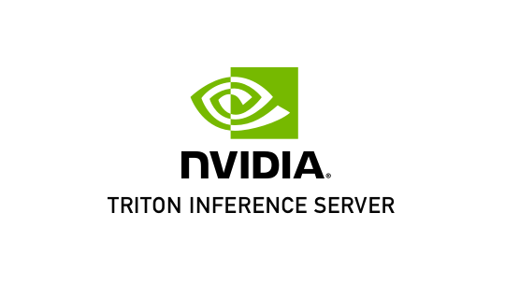
Eclipse kura and nvidia triton™: simplyfing AI on the edge
Modularity
Ready-to-use field protocols
Eclipse Kapua and IoT cloud platforms integration
Device management
Nvidia Triton Inference Server ™ integration NEW!
Notes:
We think that Eclipse Kura is a good candidate to apply Edge AI concepts to the real world due to its modularity, capability to collect data from field devices and publish on the cloud.
The new integration with Nvidia Triton Inference Server ™ will provide all we need to run AI algorithm on the edge. Leading solution…
Integration added in the latest release of Kura.

Slide 7
Know your dragon: Eclipse Kura AI APIs
Notes:
Let’s see how Kura can manage and run AI algorithms.

Slide 8
Know your dragon: Eclipse Kura AI APIs
Kura 5.1.0 introduced a new set of APIs for managing Inference Engines [1,2]
An Inteference Engine is a library or a service that accepts multiple files describing an AI and ML models and allow to perform inference on data.
The first implementation is based on the Nvidia™ Triton Inference Server [3, 4]

Slide 9
Nvidia™ Triton Inference Server
The Nvidia ™ Triton Server is an open-source inference service software that enables the user to deploy trained AI models from any framework on GPU or CPU infrastructure.
It supports all major frameworks like TensorFlow, TensorRT, PyTorch, ONNX Runtime and even custom framework backend.
It is provided in native and container fashion
GPU and CPU accelerated
Notes:
Why Nvidia Triton Server? It is open source, mature, well supported. It is compatible with the major frameworks and deep learning libraries.

Slide 10
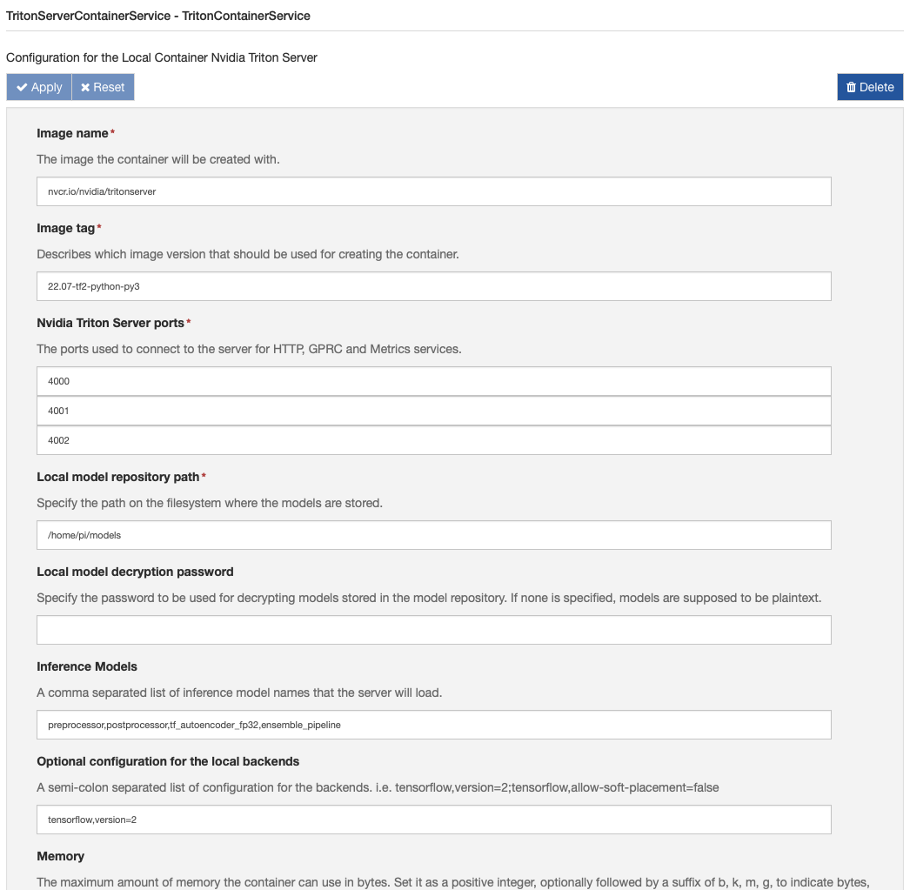
Know your dragon: Eclipse Kura AI implementation
Kura provides three components for exposing the Triton Server functionality [5, 6]:
TritonServerRemoteService
TritonServerNativeService
TritonServerContainerService
Your AI models are important: let’s encrypt them!

Slide 11
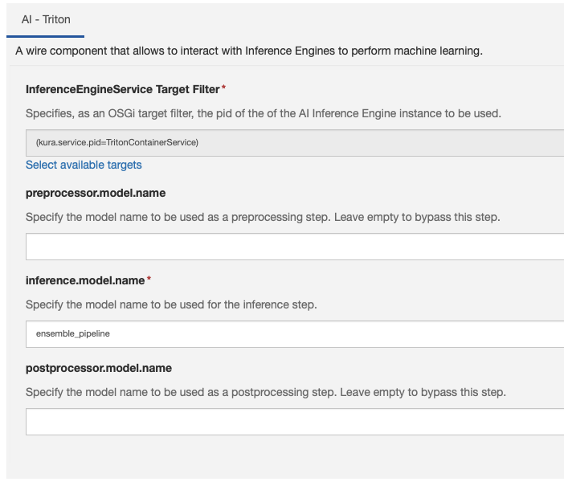
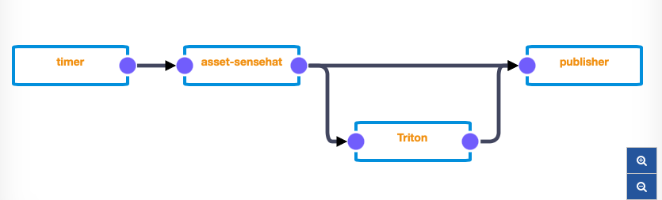
Know your dragon: Eclipse Kura AI Wire component
The AI Wire Component can power up your Wire Graph!
Notes:
It is possible to integrate the Triton Servier in a standard wire graph, integrating the usual flow with ML capabilities. Mattia will give you more details in the tutorial part.

Slide 12
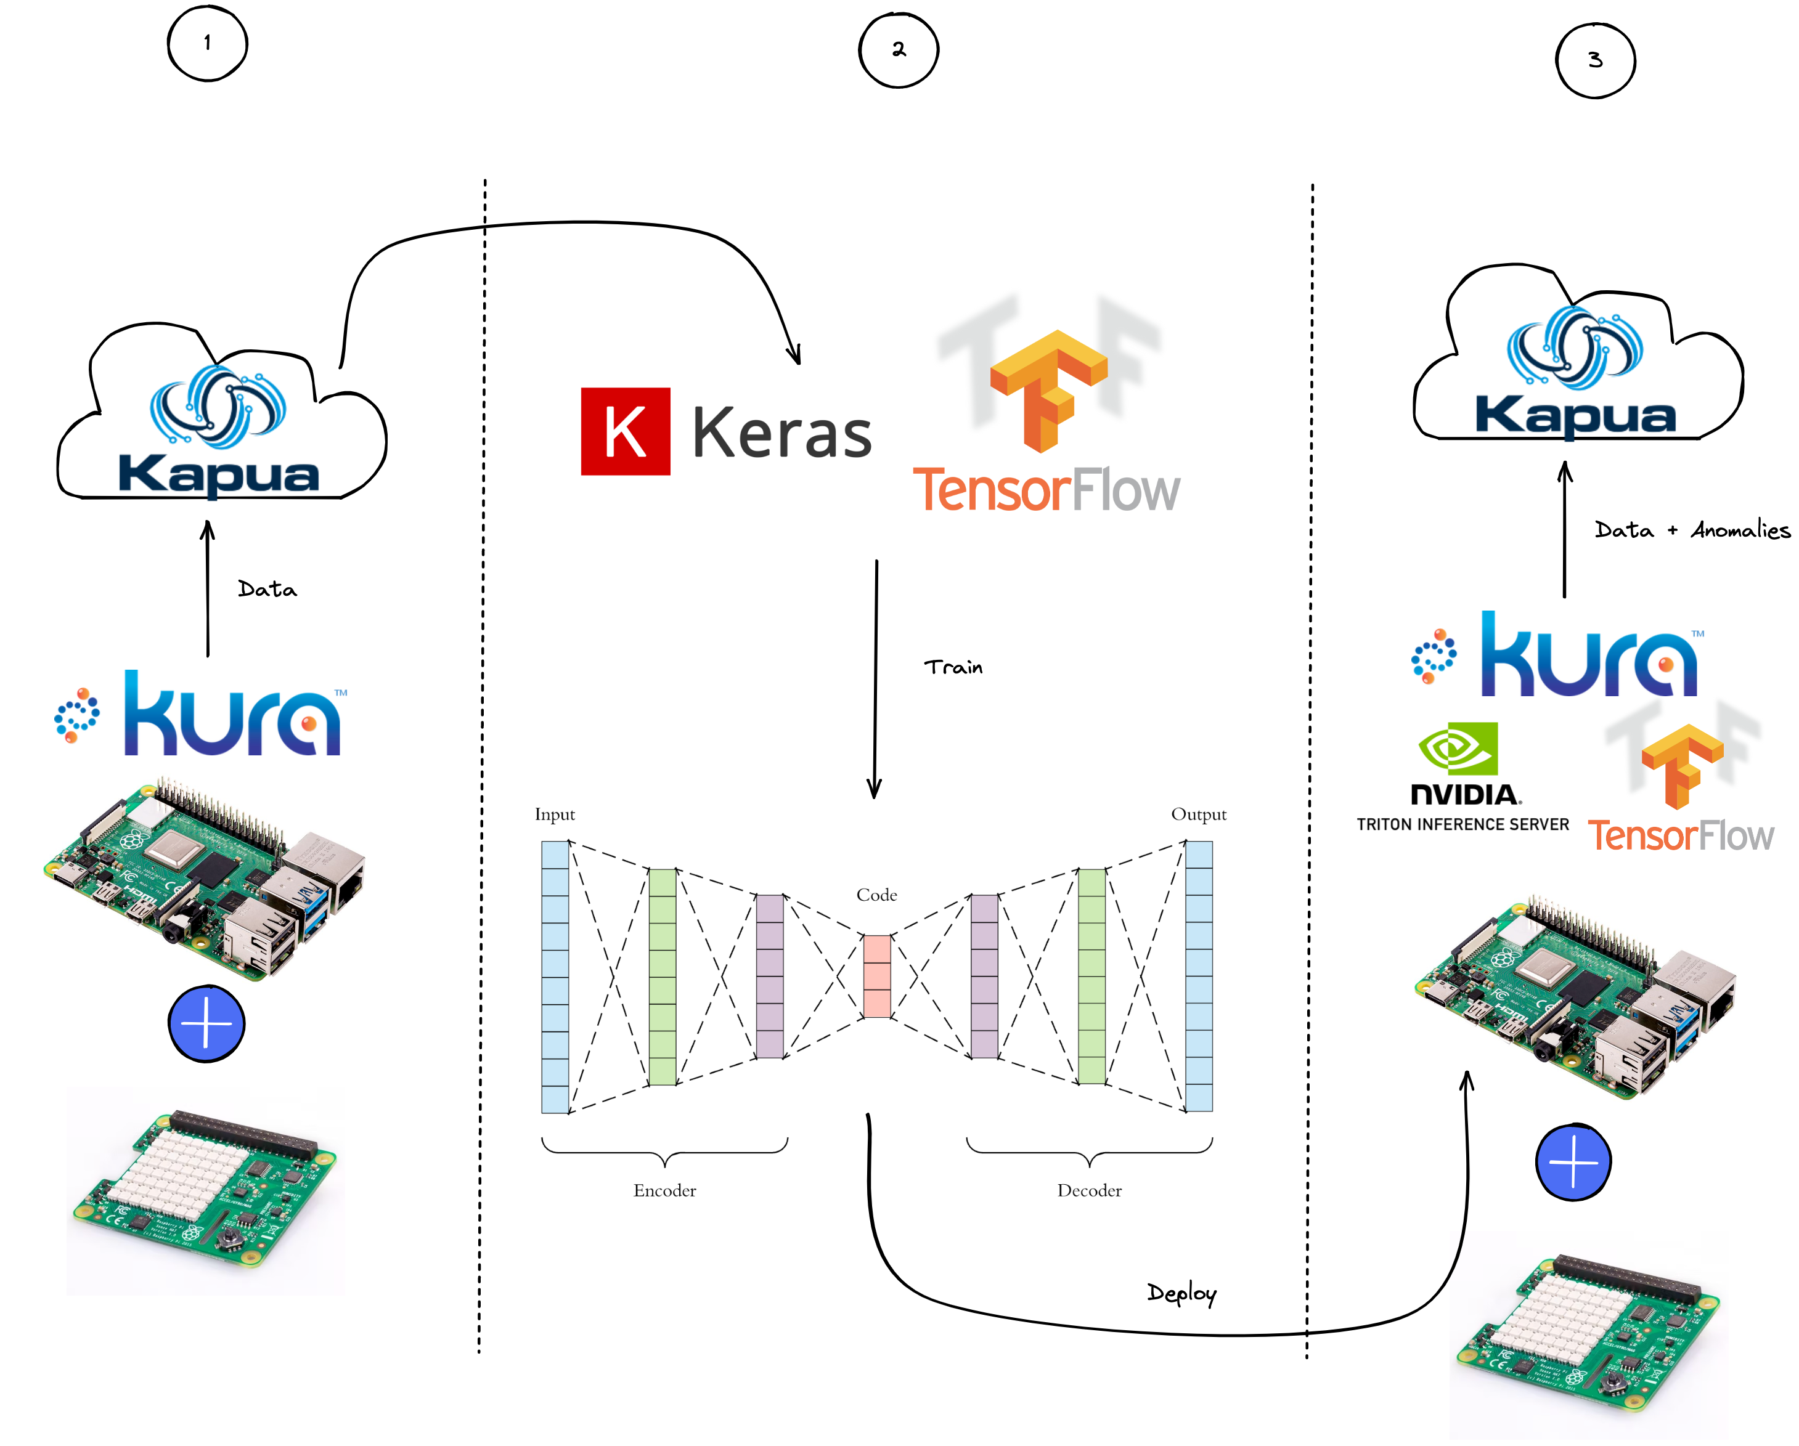
What problem are we going to solve today?
Create a deep learning anomaly detector from scratch, leveraging the entire Eclipse Kura ecosystem:
Data collection
Model building and training
Model Deployment
Notes:
So, what we want to demonstrate today? We want to use Kura and Kapua for running a ML model on a edge device. In particular, we’ll focus on…

Slide 13
Introduction to Anomaly Detection
Notes:
But before starting the tutorial we need a (short) introduction on the anomaly detection concepts.

Slide 14

What is an Anomaly?
A pattern in data that do not conform to a well-defined notion of normal behavior [7].
A data point which differs significantly from other data points.
An observation which deviates so much from other observations as to arouse suspicions that it was generated by a different mechanism [8].
https://unsplash.com/photos/0inyFl3j_rc
Notes:
The main topic is how to detect anomalies in our application.

Slide 15

Why Anomaly Detection?
The importance of anomaly detection is due to the fact that anomalies in data translate to significant (and often critical) actionable information in a wide variety of application domains [7].
Finding anomalies is useful in several domains as cyber security, industry, IoT, robotics, etc.
Anomaly detection can be applied for intrusion and fraud detection, fault detection, etc.
https://unsplash.com/photos/fiXLQXAhCfk
Notes:
Why Anomaly detection is so important? An anomaly has information on how our system deviates from the standard behavior and can trigger action for correct it.

Slide 16

How to detect anomalies?
Statistical analysis:
Threshold, proximity and deviation
Machine Learning algorithms:
Supervised
Decision trees, XGBoost, …
Semi-supervised
Autoencoders, …
Unsupervised
GANs, …
https://xkcd.com/1838/
Notes:
The classical approach is the statistical analysis, but the last years ML algorithms have been successfully used. In this presentation, we’ll use an autoencoder: a semi-supervised ML model.

Slide 17
What IS aN Autoencoder?
An Autoencoders is a specific semi-supervised (or self-supervised) ML algorithm used in several applications
An Autoencoder tries to reconstruct the input at the output
It consists of an Encoder and a Decoder
The Encoder is a NN that maps the input to a lower-dimensional space (code)
The Decoder is a NN that maps encoded data back to the input
The algorithm is trained to have a small reconstruction error
Anomalies tipically have high reconstruction error
Input: X
Output: X’
X – X’
Reconstruction Error
Notes:
Few words on how works an autoencoder.

Slide 18
Tutorial

Slide 19

Tutorial
https://colab.research.google.com/github/mattdibi/eclipsecon-edgeAI-talk/blob/master/notebook/AD-EdgeAI.ipynb

Slide 20
Upcoming features
Support for more ML backends:
Intel™ OpenVINO ™
Eclipse Deeplearning4j
Contributions are welcome!
Notes:
Kura APIs are generic enougth to be implemented with different tools. We started with the Triton server, but there are many good libraries. Two of them are the Intel OpenVINO and the Eclipse Deeplearning4j that we would integrate.

Slide 21
Questions?

Slide 22
Interested in the cover image?
Look here!
https://labs.openai.com/s/kDAkiocHXgKDY0j3utSLFPlj

Slide 23
REFERENCES
[1] https://github.com/eclipse/kura/blob/KURA_5.1.0_RELEASE/kura/distrib/RELEASE_NOTES.txt
[2] https://github.com/eclipse/kura/tree/develop/kura/org.eclipse.kura.api/src/main/java/org/eclipse/kura/ai/inference
[3] https://developer.nvidia.com/nvidia-triton-inference-server
[4] https://github.com/triton-inference-server
[5] https://github.com/eclipse/kura/blob/KURA_5.2.0_RELEASE/kura/distrib/RELEASE_NOTES.txt
[6] https://eclipse.github.io/kura/docs-release-5.2/core-services/nvidia-triton-server-inference-engine/
[7] Chandola, V.; Banerjee, A.; Kumar, V. (2009). "Anomaly detection: A survey". ACM Computing Surveys. 41 (3): 1–58. doi:10.1145/1541880.1541882. S2CID 207172599.
[8] Hawkins, Douglas M. (1980). Identification of Outliers. Chapman and Hall London; New York.

